Slide 1
WELCOME

Slide 2
Project Name
Community Clinic Management System (CCMS)

Slide 3
Submission Supervision
Submitted By
------------------------------------------------
Md. Golam Habib (160221001)
Md. Ashikur Rahman (160221005)
MD. Nazrul Islam (160221006)
Md. Elias Hossain (160221007)
Aktarul Islam (160221008)
Habiba Arfin (160221009)
Supervised By
------------------------------------------------
MD. OBAIDUR RAHMAN
Associate Professor & Chairman
Computer Science and Engineering (CSE)
European University of Bangladesh

Slide 4
Project Intro
Healthcare is now a burning issue not only Bangladesh but all over the world. To ensure equitable healthcare for every resident in Bangladesh, an extensive network of health services has been established. Bangladesh has achieved notable progress on different health parameters.
Infrastructure of healthcare facilities can be divided into three levels: medical universities,
medical college hospitals, and
specialty hospitals exist at the tertiary level.
District hospitals, maternal and child welfare centers are considered to be on the secondary level. Upazila health complexes, union health & family welfare centers, and community clinics (lowest-level healthcare facilities) are the primary level healthcare providers.

Slide 5

Community Clinic
Community Clinic
A healthcare center, health center, or community health center is one of a network of clinics staffed by a group of general practitioners and nurses providing healthcare services to people in a certain area.
Bangladesh has established more than 13,000 community clinics (CCs) to provide primary healthcare.

Slide 6
CCMS
Our Project
Cloud based Health Care Monitoring system from root level of public health. Consist of hardware equipment's, Data and a System.
Community Clinic Management System

Slide 7
CCMS
Our Project
Though it’s a too much very big project, in this regard we have worked with
basic management of system and
ECG data analysis

Slide 8

Health
Need to know
Electrocardiography
Electrocardiography is the process of producing an electrocardiogram. It is a graph of voltage versus time of the electrical activity of the heart using electrodes placed on the skin.

Slide 9
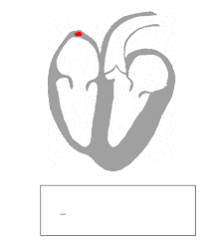
Health
ECG
An electrocardiogram (ECG) is a simple test that can be used to check your heart's rhythm and electrical activity.

Slide 10
ECG Components
ECG Component
There are three main components to an ECG: the P wave, which represents the depolarization of the atria; the QRS complex, which represents the depolarization of the ventricles; and the T wave, which represents the repolarization of the ventricles.

Slide 11
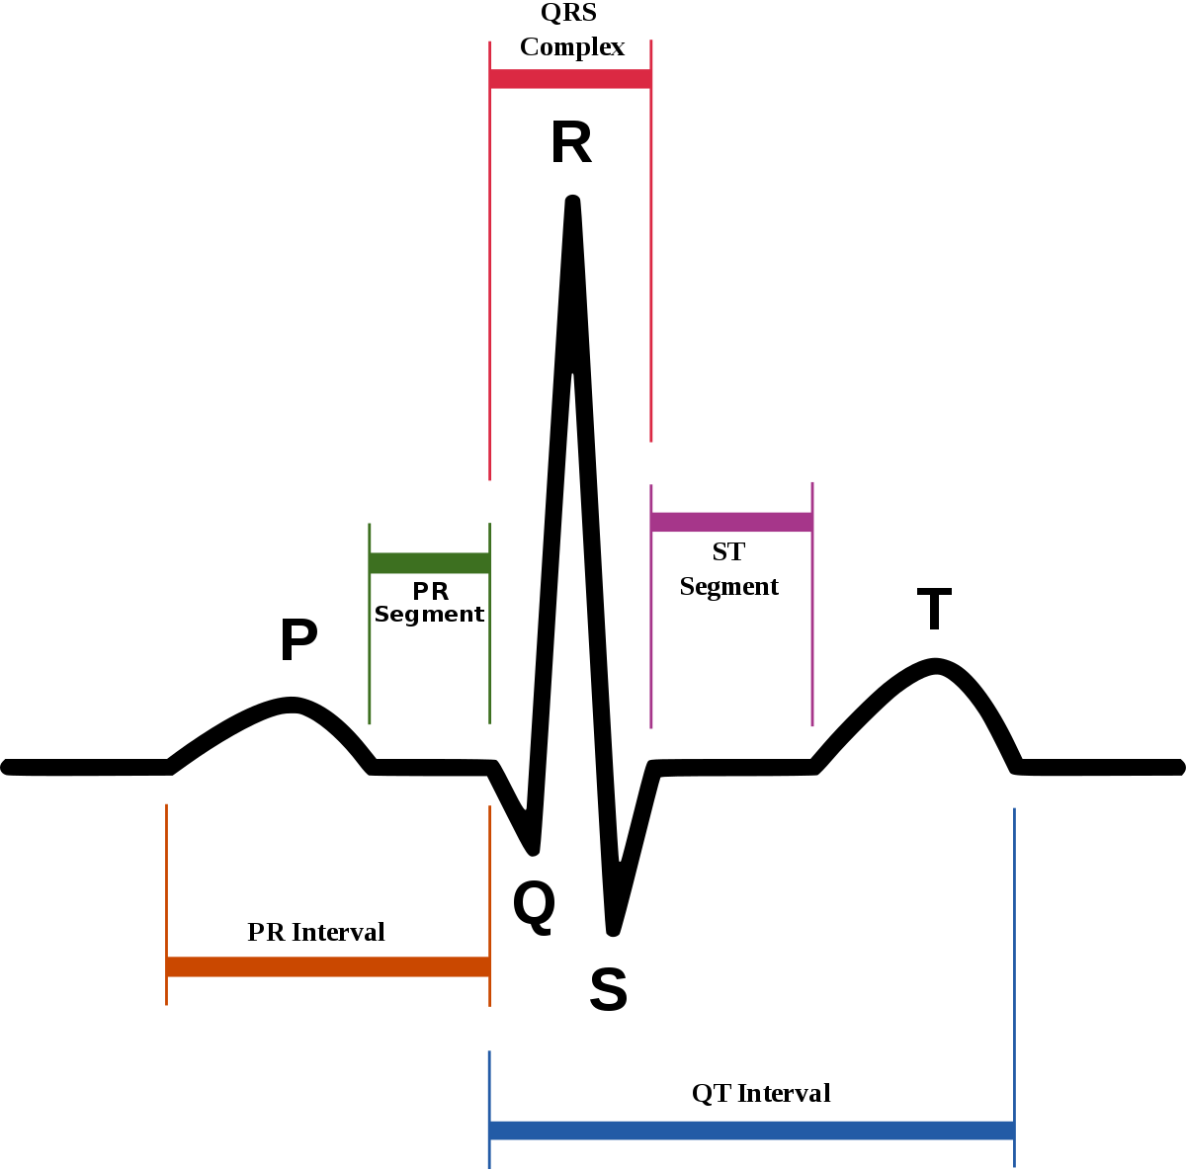
ECG Components
ECG Component
P wave
Q wave
R wave
S Wave
T wave
PQ Interval
RR Interval
QRS Complex
ST Segment
QT Interval

Slide 12
Projects consisting parts
Our Project
Our Project has 2 part
Hardware Part
Software Part

Slide 13
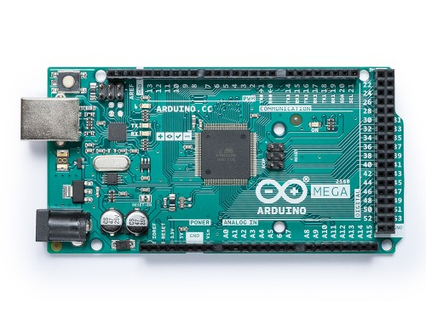
Hardware We Used For This Project
Arduino Mega 2560
The Mega 2560 is a microcontroller board based on the AT mega2560. It has 54 digital input/output pins, a 16 MHz crystal oscillator, a USB connection, a power jack, an ICSP header, and a reset button. It contains everything needed to support the microcontroller; simply connect it to a computer with a USB cable or power it with a AC-to-DC adapter or battery to get started.

Slide 14
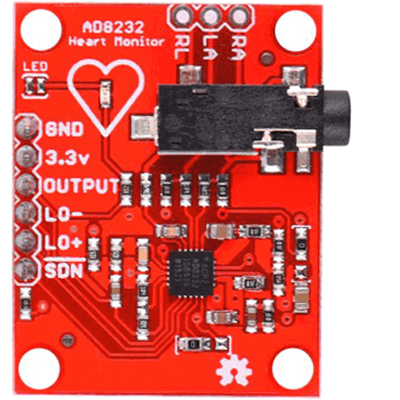
Hardware We Used For This Project
AD8232 Heart Rate Monitor
The AD8232 is a neat little chip used to measure the electrical activity of the heart. This electrical activity can be charted as an ECG or Electrocardiogram.
Electrocardiography is used to help diagnose various heart conditions.

Slide 15
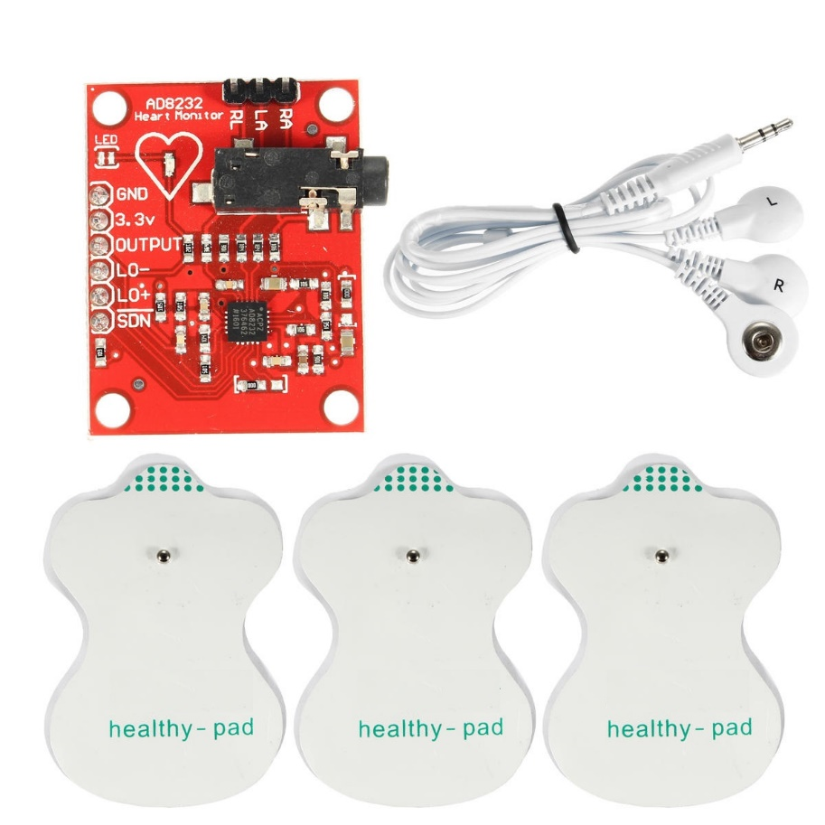
Hardware We Used For This Project
AD8232 ECG Sensor Module
ECG also known as Electrocardiogram is a noninvasive medical procedure to measure the electrical activity of the Heart. This process of measuring the heart activity is called as Electrocardiography. This ECG Sensor Module measures this activity and gives an output.

Slide 16
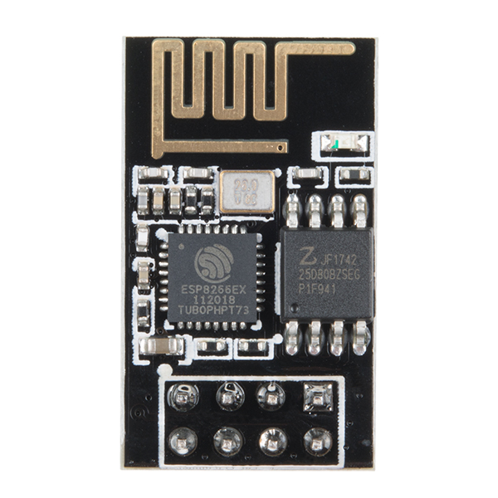
Hardware We Used For This Project
ESP8266 Al Cloud Inside
The ESP8266 Wi-Fi Module is a self contained SOC with integrated TCP/IP protocol stack that can give any microcontroller access to your Wi-Fi network. The ESP8266 is capable of hosting an application or offloading all Wi-Fi networking functions from another application processor.

Slide 17
Hardware We Used For This Project
CP2102 USB 2.0 to TTL UART Module converter
The ESP8266 Wi-Fi Module is a self contained SOC with integrated TCP/IP protocol stack that can give any microcontroller access to your Wi-Fi network. The ESP8266 is capable of hosting an application or offloading all Wi-Fi networking functions from another application processor.

Slide 18
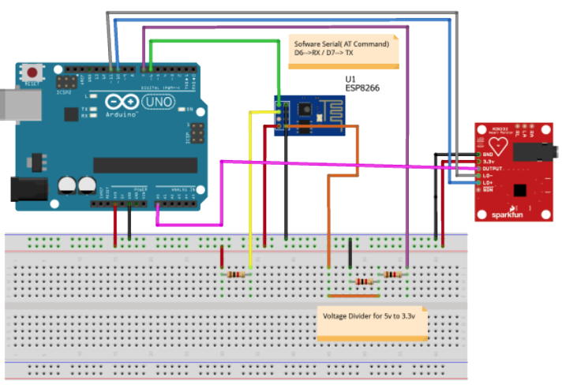

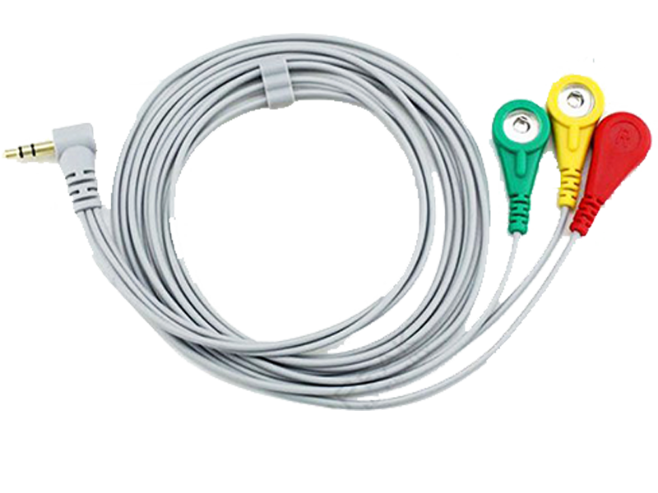
Circuit Diagram of the Project
All Connection of this project

Slide 19
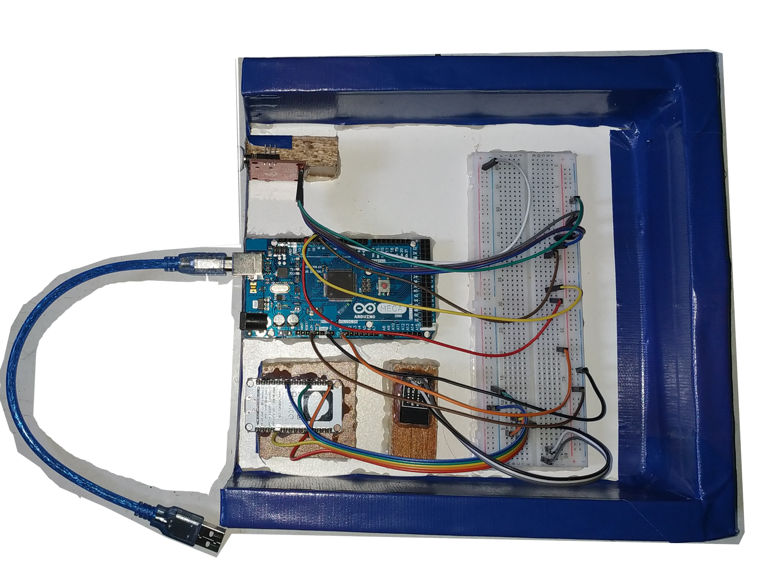
Introduce With Hardware
Final Output of the Device

Slide 20
Thank You

